Slide 1

Databases
By: Manoja Weerasekara

Slide 2
SQL-Session 2

Slide 3
Quick Recap:
What are the current databases at the server?
mysql> show databases;
Create a database (make a directory) whose name is MyDB
mysql> create database MyDB;
Select MYDB database to use
mysql> use MyDB;
What tables are currently stored in the MyDB database?
mysql> show tables;
Display all the properties of Student table of a selected tables (Test)?
mysql> describe table Test;

Slide 4
Quick Recap:
Create a new table (Student) called with following fields.
StudentID – Integer(10)- PK
StudentName – Varchar(150) – Not Null
MobileNo.- Varchar(10)
DoB-DATE-Not null
Insert 2 new records to the table.
Insert the 3rd record, enter only the ID,name and DoB
Write a command to delete the table Student
Write a command to delete the database MyDB

Slide 5
Create Tables
CREATE TABLE table_name (column_name column_type);
create table Book(
book_id INT NOT NULL AUTO_INCREMENT,
book_title VARCHAR(100) NOT NULL,
book_author VARCHAR(40) NOT NULL,
submission_date DATE,
PRIMARY KEY (book_id )
);

Slide 6
Insert Data into a Table
Insert Records to a Table
INSERT INTO <table_name>
VALUES (… , …. , …..);
INSERT INTO Student
VALUES (1001, ‘Ann Perera’, ‘105, Cinnoman Gardens, Colombo 7’, ‘1995/10/13’, ‘0115446000’, ‘F’);
Insert Data Selected field in a Table
INSERT INTO table_name ( field1,field2,...fieldN )
VALUES
( value1, value2,...valueN );
INSERT INTO Student
(StudentID, ContactNo, Age, StudentName)
VALUES (1001, ‘0115446000’, 22, ‘Ann Perera’);

Slide 7
INSERT INTO Book
(book_title, book_author, submission_date)
VALUES
("Learn DB", “Elmasri", NOW());

Slide 8
Fetching Data from a Table: Select
The data retrieved from tables is temporarily stored in a resulting table, called as a result-set.
Can specify the field names of the table you want to select data from.
Wildcard character * (asterisk) is used to select all the fields available in the table.
SELECT field1, field2,...fieldN
FROM table_name1, table_name2...

Slide 9
Select all the records in a table with all the fields:
SELECT * FROM <Table_Name>;
SELECT * from Book;
Select specific fields in a table with all the records:
SELECT <Field names>
FROM <Table_Name>;
SELECT book_id, book_title from Book;

Slide 10
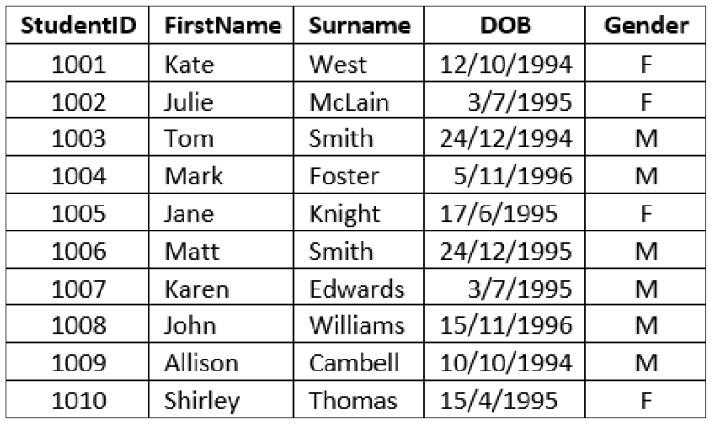

Slide 11
Display all the details of students.
Display ID and name of all students.

Slide 12
Filter Data: Where
Used to filter records.
It is used to extract only the records that fulfill a specified condition.
It is mostly used in statements like:
–SELECT
–UPDATE
–DELETE
SELECT field1, field2,...fieldN
FROM table_name1, table_name2...
[WHERE Clause]

Slide 13
Select the records which satisfy a condition with all the fields of the table:
SELECT * FROM <Table_Name>
WHERE <Condition>;
Select the records which satisfy a condition with specific fields in a table:
SELECT <Field names>
FROM <Table_Name>
WHERE <Condition>;

Slide 14
Basic SELECT statements with Operators:
Arithmetic Operators
Comparison/Relational Operator
Logical Operator

Slide 15
Using arithmetic operators in SQL statements
SQL commands are often used in conjunction with arithmetic operators.
As you perform mathematical operations on attributes, remember the rules of precedence.
1. Perform operations within parentheses
2. Perform power operations
3. Perform multiplications and divisions
4. Perform additions and subtractions

Slide 16
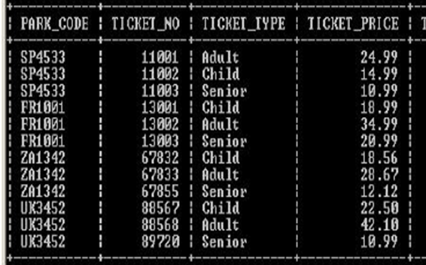

Slide 17
Suppose the owners of all the theme parks wanted to compare the current ticket prices, with an increase in the price of each ticket by 10% .
You’re required to show all the ticket details in the Ticket table.

Slide 18
SELECT PARK_CODE, TICKET_NO, TICKET_TYPE, TICKET_PRICE,
TICKET_PRICE + ROUND((TICKET_PRICE *0.1),2)
FROM TICKET;

Slide 19
SELECT PARK_CODE, TICKET_NO, TICKET_TYPE, TICKET_PRICE, TICKET_PRICE + ROUND((TICKET_PRICE *0.1),2) PRICE_INCREASE
FROM TICKET;
or
SELECT PARK_CODE, TICKET_NO, TICKET_TYPE, TICKET_PRICE, TICKET_PRICE + ROUND((TICKET_PRICE *0.1),2) AS
“PRICE INCREASE”
FROM TICKET;

Slide 20
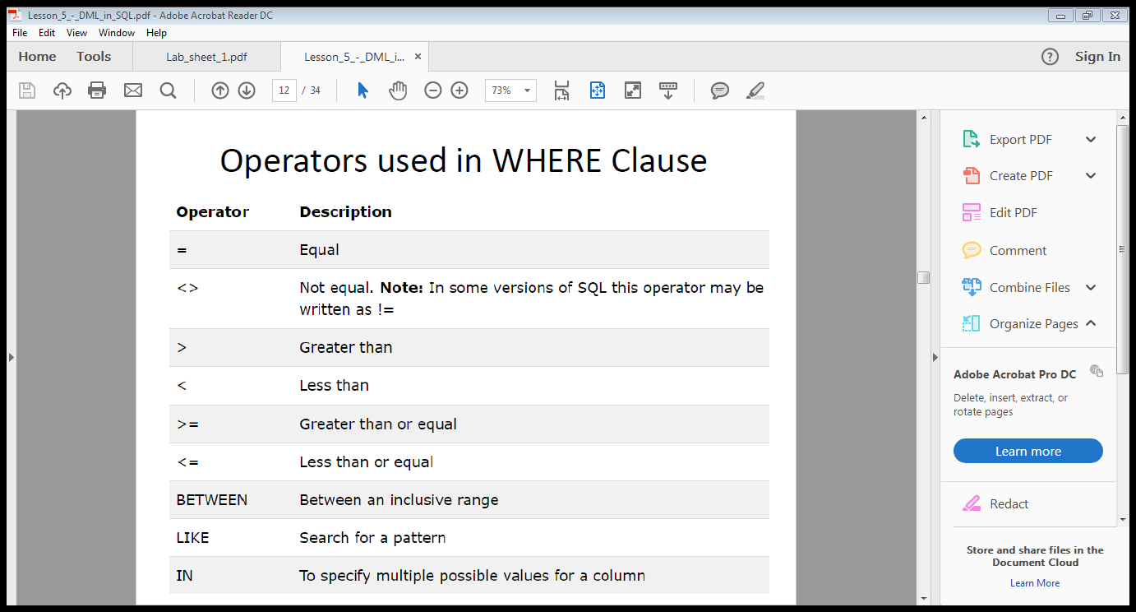
Comparison Operators

Slide 21
SELECT * from Book
WHERE book_author = ‘Elmasri';
How to select book id of the book written by Elmasri

Slide 23
Display all the details of female students.
Display ID and first name of all students whose surname is Smith.

Slide 24
Next:
Display the theme park code, ticket price and ticket type of all tickets where the ticket price is greater than 20.00

Slide 25
SELECT PARK_CODE, TICKET_TYPE, TICKET_PRICE
FROM TICKET
WHERE TICKET_PRICE > 20;

Slide 26
Next: if you want to see a listing for all tickets whose prices are between €30 and €50.
What is the operator that we can use?

Slide 27
The operator BETWEEN may be used to check whether an attribute value is within a range of values.
SELECT *
FROM TICKET
WHERE TICKET_PRICE BETWEEN 30.00 AND 50.00;

Slide 28
Select all customers that are located in "Germany", "France" and "UK":
Select all customers that are NOT located in "Germany", "France" or "UK":

Slide 29
SELECT * FROM Customers WHERE Country IN ('Germany', 'France', 'UK');
SELECT * FROM Customers WHERE Country NOT IN ('Germany', 'France', 'UK');

Slide 30
Thank You

